Slide 1
LiveReload
JShelf Team

Slide 2
Principle
New a websocket server to listen the src folder changes, then push to browser.
Browser Plugin will add a js when load page, and new a connection to the websocket server.

Slide 3
Install
UI
http://livereload.com/
Browser Plugin
https://addons.mozilla.org/en-US/firefox/addon/livereload/
https://chrome.google.com/webstore/detail/livereload/jnihajbhpnppcggbcgedagnkighmdlei?hl=zh-CN
Gulp lib
npm install --save-dev gulp-livereload

Slide 4
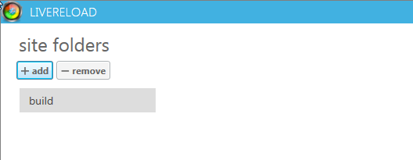
UI

Slide 5
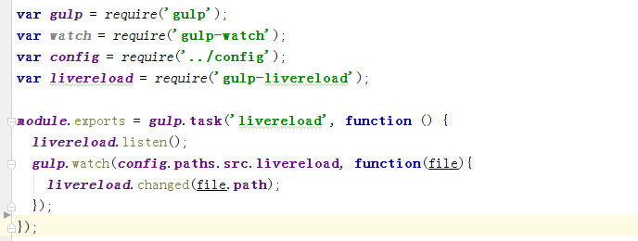
Gulp Lib

Slide 6
Docker
JShelf Team

Slide 7
What’s Docker
Docker is an open platform for developers and sysadmins to build, ship, and run distributed applications….
Application Container

Slide 8
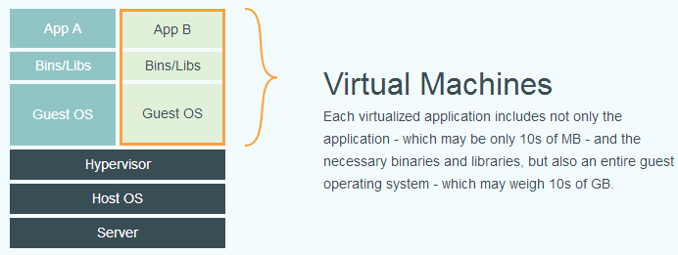
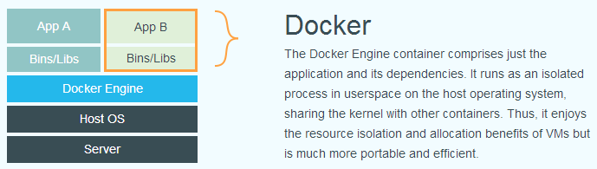
Why Docker

Slide 9
Why Docker
更高效的虚拟化
易于迁移与扩展
更简单的管理

Slide 10
Concept
镜像（Image）
容器（Container）
仓库（Repository）

Slide 11
Images
Docker images
Docker pull dl.dockerpool.com:5000/ubuntu:14.04
Docker push
Docker rmi training/sinatra
Docker save -o ubuntu_14.04.tar ubuntu:14.04
Docker load --input ubuntu_14.04.tar

Slide 12
Containers
Docker ps
docker run -t -i ubuntu:14.04 /bin/bash
docker attach/nsenter
Docker export/import
Docker rm
Docker stop/kill/restart

Slide 13
Repository
Docker login
Docker search
docker-registry

Slide 14
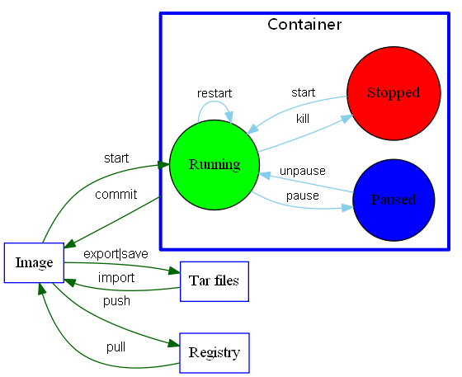
常用命令

Slide 15
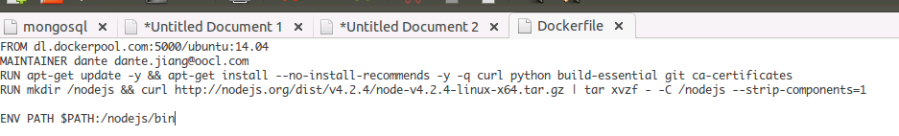
Dockerfile
Dockerfile 分为四部分：基础镜像信息、维护者信息、镜像操作指令和容器启动时执行指令

Slide 16
Dockerfile
FROM, MAINTAINER, RUN, CMD, EXPOSE, ENV, ADD, COPY, VOLUME…
sudo docker build -t nodejs .

Slide 17
Docker底层实现
Linux 内核
Namespace: 用来隔离不同container的执行空间
Cgroup：用来分配硬件资源
AUFS：用来建立不同container的档案系统
SELinux：用来确保container的网络安全
Linux Bridge, Netlink:用来让container之间进行通信

Slide 18
Docker底层实现
Docker 组件
Docker client
Docker daemon
Libcontainer
Docker image

Slide 19
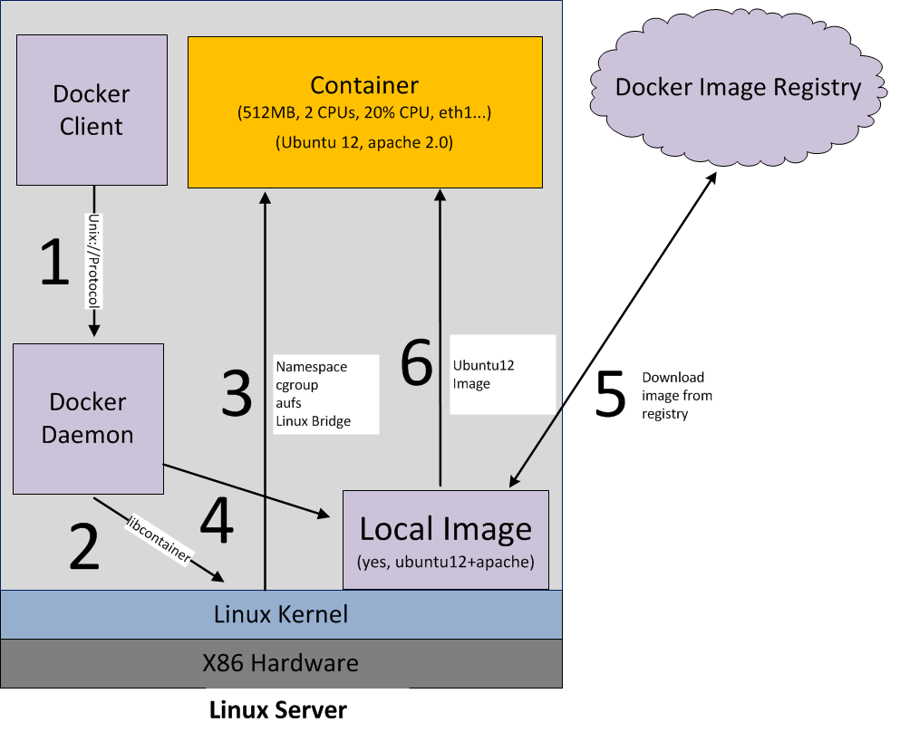

Slide 20
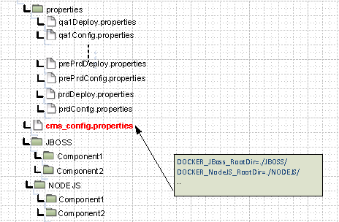
CMS
Properties folder
MUST under root directory
{env}Config. properties -- used for vpp replacement
{env}Deploy.properties -- defined deployment info
cms_config.properties
MUST under root directory
Define the root folder of Jboss app or Nodejs app.
The key MUST “DOCKER_<JBOSS or NODEJS>_RootDir”
Application code should be group by technology

Slide 21
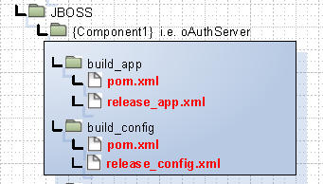
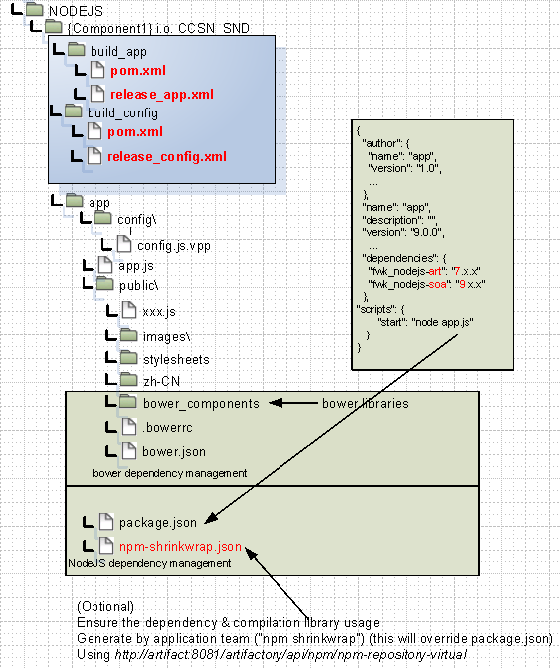
CMS
build_app
build_config
app (ONLY for NodeJS)

Slide 22
CMS
build_app/pom.xml -> package and deploy for application code
build_app/release_app.xml -> zip the app code (ONLY for Nodejs)
build_config/pom.xml -> package and deploy for config files
build_config/release_config.xml -> zip the config files after vpp replacement

Slide 23
CMS
artifactId name in pom.xml
NodeJS: NJ_xxxx and NJ_xxxx_config
Jboss: JB_xxxx and JB_xxxx_config
{env}DeployConfig.properites
{artifactId}.nodejs_version=4.2.3.1 → ONLY for nodejs
{artifactId}.servers=hln2186p
{artifactId}.destFolder=/home/njccsn_snd
{artifactId}.port=3016
http://ooclwiki.oocl.com/index.php/OOCL_NodeJS_Docker_Template
http://i2isd/sites/Systems/IR4sys/Lists/Docker%20Application/AllItems.aspx

Slide 24
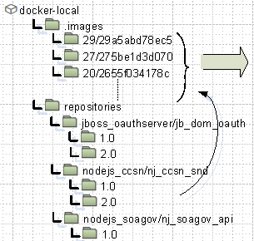
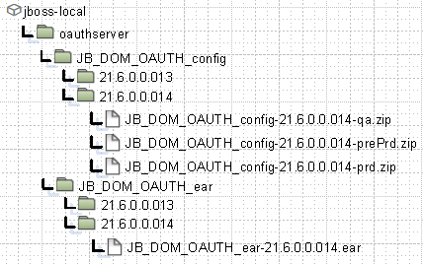
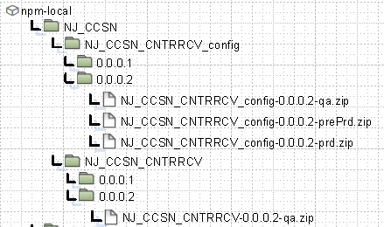
CMS
For Jboss,
docker image -> docker_local repos in artifactory
ear file and config zip files -> jboss_local repos
For NodeJS
docker image -> docker_local repos in artifactory
app zip file and config zip files -> npm_local repos
http://artifact:8081/artifactory/webapp/

Slide 25


CMS
Application in docker should listen on 8080 port.
Jboss application
Write log to /home/jboss/log
Load config from /home/jboss/config
For other files used by app, /home/jboss/files
NodeJS application
Write log to /home/node/logs
Load config from /home/node/config
For other files used by app, /home/node/files
Docker RUN script will handle the mapping relationship between docker container and target server

Slide 26
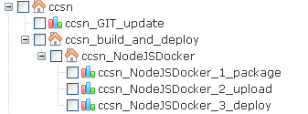
CMS
GIT_update -> get latest change from GIT
package -> invoke mvn install for app and config
upload
Invoke mvn deploy to upload items to artifactory.
Execute “npm install” if it is nodejs app. Build image, push the image to artifact
deploy
In artifact, download the config zip file, invoke AMP, zip the config files, transfer to target servers
In target server, unzip it to config folder
In target server, PULL the image from artifact and RUN it.

Slide 27
CMS
FROM artifact.oocl.com/oocl/nodejs:4.2.4.1 COPY app/ /home/node/ CMD ["npm", "start"]

Slide 28
CMS
sudo docker run --name=${CONTAINERNAME} --privileged=true --restart=always -v ${HOME_DIR_NAME}/config:/home/jboss/config -v ${HOME_DIR_NAME}/logs:/home/jboss/logs -v ${HOME_DIR_NAME}/files:/home/jboss/files -v /etc/passwd:/etc/passwd -v /etc/group:/etc/group -v /home/sso/${ENV}/agent-config.txt:/home/jboss/config/agent-config.txt -p ${PORT}:8080 -p ${ADMINPORT}:9990 -p ${CLIPORT}:9999 -i -d -t ${IMAGE_NAME}

Slide 29
Thanks!

